Slide 1

Channel Estimation

Slide 2

* Channel estimation plays an important part in an OFDM system. It is used for increasing the capacity of orthogonal frequency division multiple access (OFDMA) systems by improving the system performance in terms of bit error rate.
* Use channel estimation functions to estimate the channel response to aid signal recovery.

Slide 3
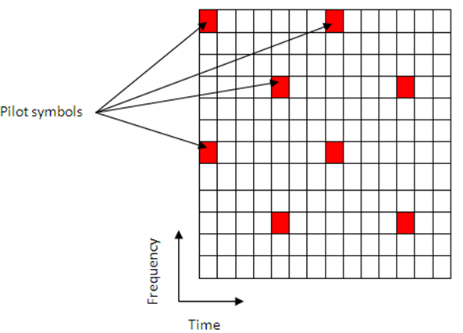
The pilot symbols in LTE are assigned positions within a subframe.

Slide 4
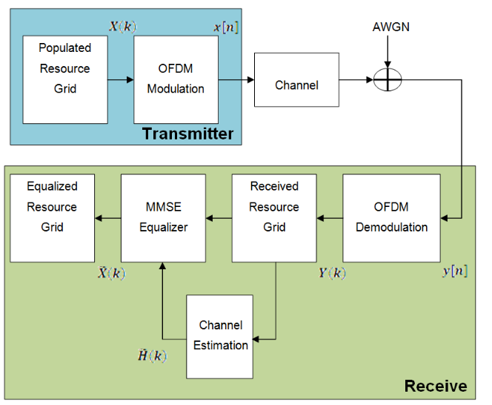

Slide 5
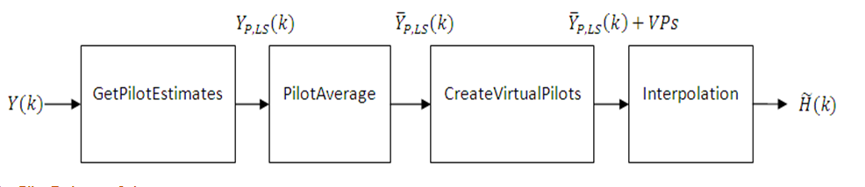
channel estimation method

Slide 6
Get Pilot Estimates Subsystem
The first step in determining the least squares estimate is to extract the pilot symbols from their known location within the received subframe. the channel response at these locations can be determined using the least squares estimate. The least squares estimate is obtained by dividing the received pilot symbols by their expected value.
˜HP(k)=YP(k)/XP(k)

Slide 7
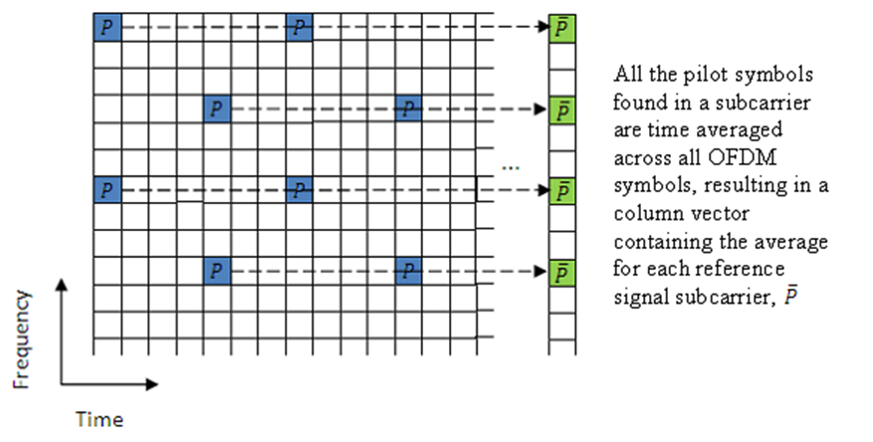
Pilot Average Subsystem

Slide 8
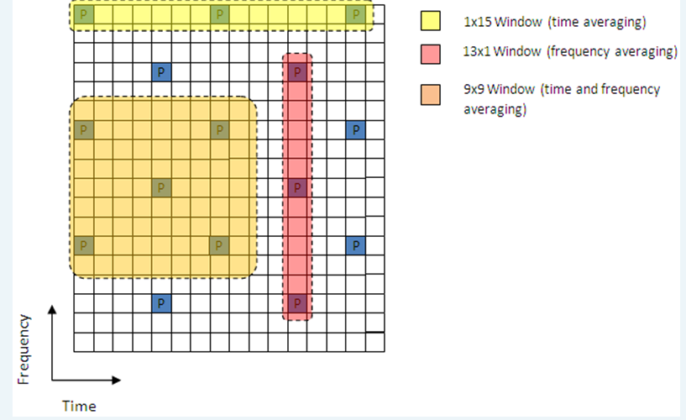
Types of averaging

Slide 9
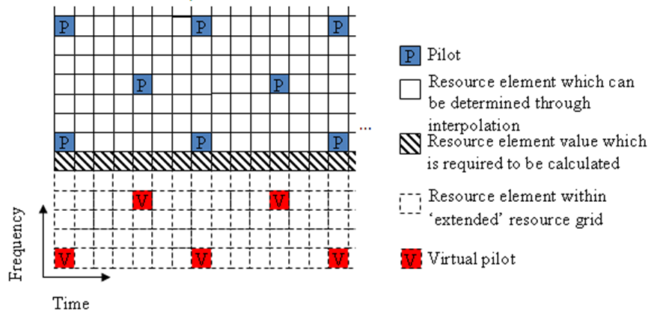
Create Virtual Pilots Subsystem

Slide 10
Interpolation Subsystem
Causal' when using past data.
'Non-causal' when using future data. It is the opposite of 'Causal'. Relying only on future data is commonly referred to as an anti-causal method of interpolation.
'Centered' or 'Centred' when using a combination of past, present, and future data.

